Slide 1
www.transamcarriers.com

Slide 2
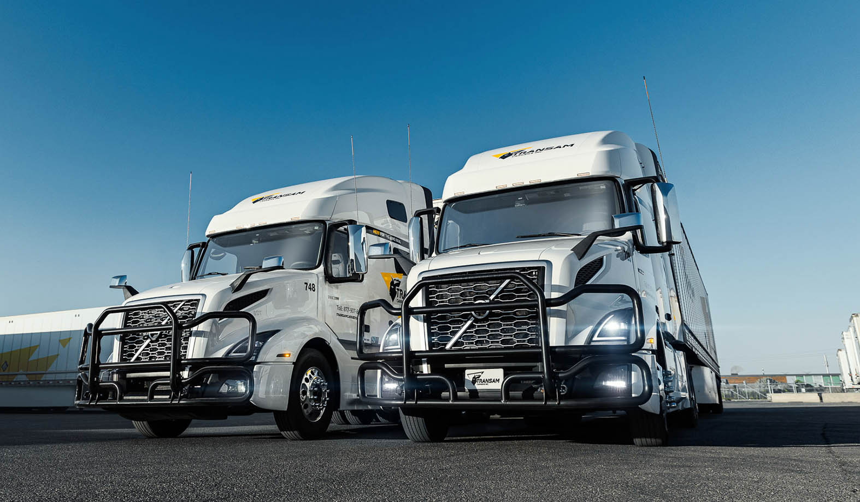
Table of Contents
1. Company History
3
2. Growth
4
3. Focus
5
4. Mission
6
5. Vision Statement
7
6. Coverage
8
7. Safety and security
9
8. Technology
10
9. Advantages
11
10. Contacts
12

Slide 3

Company History
Transam Carriers was formed in 2006 in response to an overwhelming need for a reliable transportation service provider of both LTL and truckload services. Since that time, Transam has grown to become a leader in the time definite delivery of goods throughout North America.
With a commitment to safety and employee wellbeing, Transam has become an employer of choice by front line drivers and back office support personal.
The progressive thinking team members of Transam have always displayed a “can do” attitude and have provided solutions to clients that regularly exceed their expectations.

Slide 4
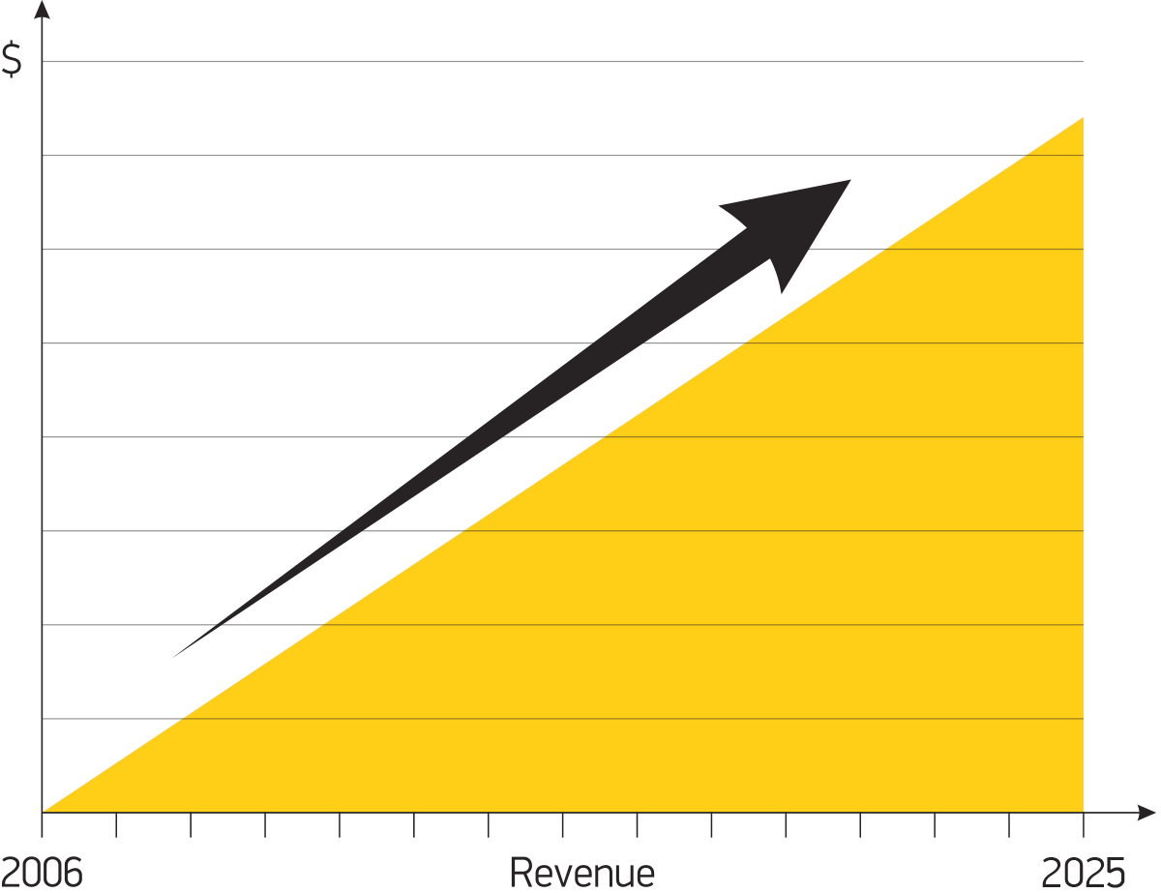
Growth
Growth chart
Growth has been the result of hard work and effort by all team members at Transam. The business has taken a conservative and calculated approach to growth making certain the product offering and service to the clients has never been compromised.
We continue to provide our customers with leading edge solutions designed to improve their bottom line. Our responsible approach to adding revenue has allowed us to add a significant number of targeted customers with many of them from the Fortune 500 list.

Slide 5
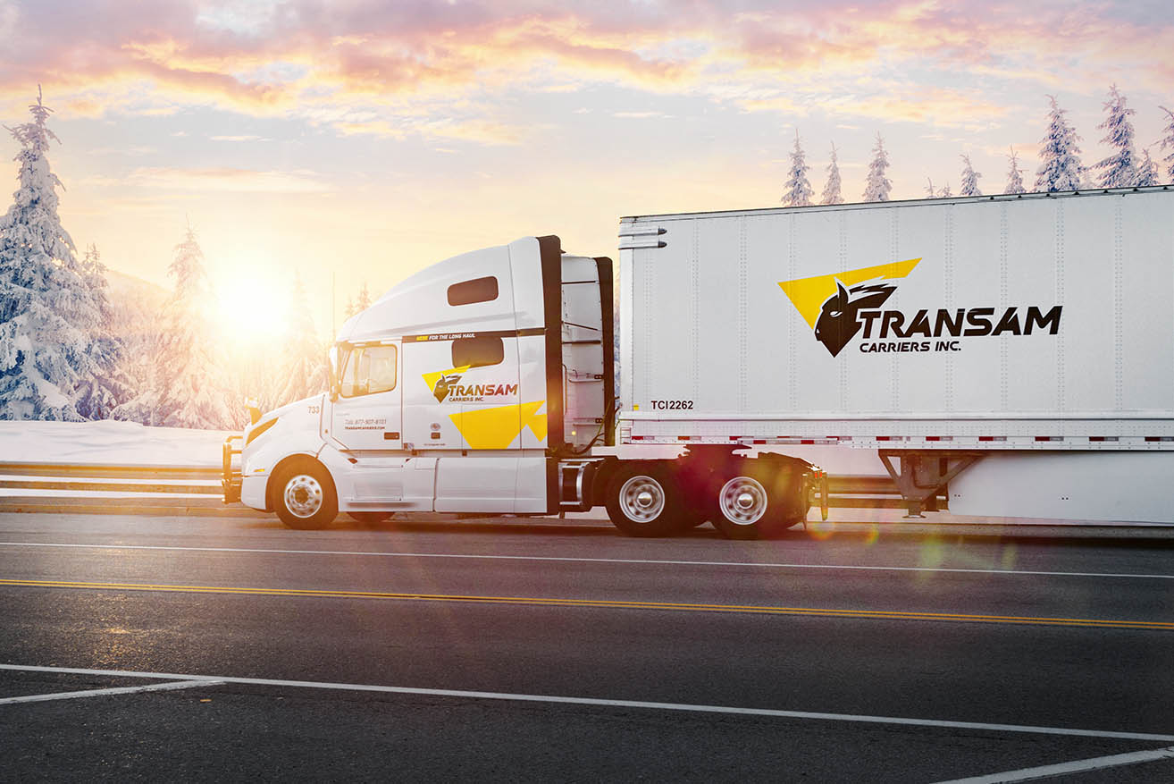
Focus
Truckload between Western Canada and Toronto
Truckload between Western Canada and Chicago/Midwest USA
LTL between Toronto and Chicago
Truckload between Toronto
and Chicago/Midwest USA
LTL to Western Canada from Toronto/Chicago
LTL between Toronto and the northeastern states of the USA
LTL services between Toronto
and Ohio
Truckload between Toronto
and Ohio/Michigan
LTL and Truckload between Toronto and Montreal

Slide 6
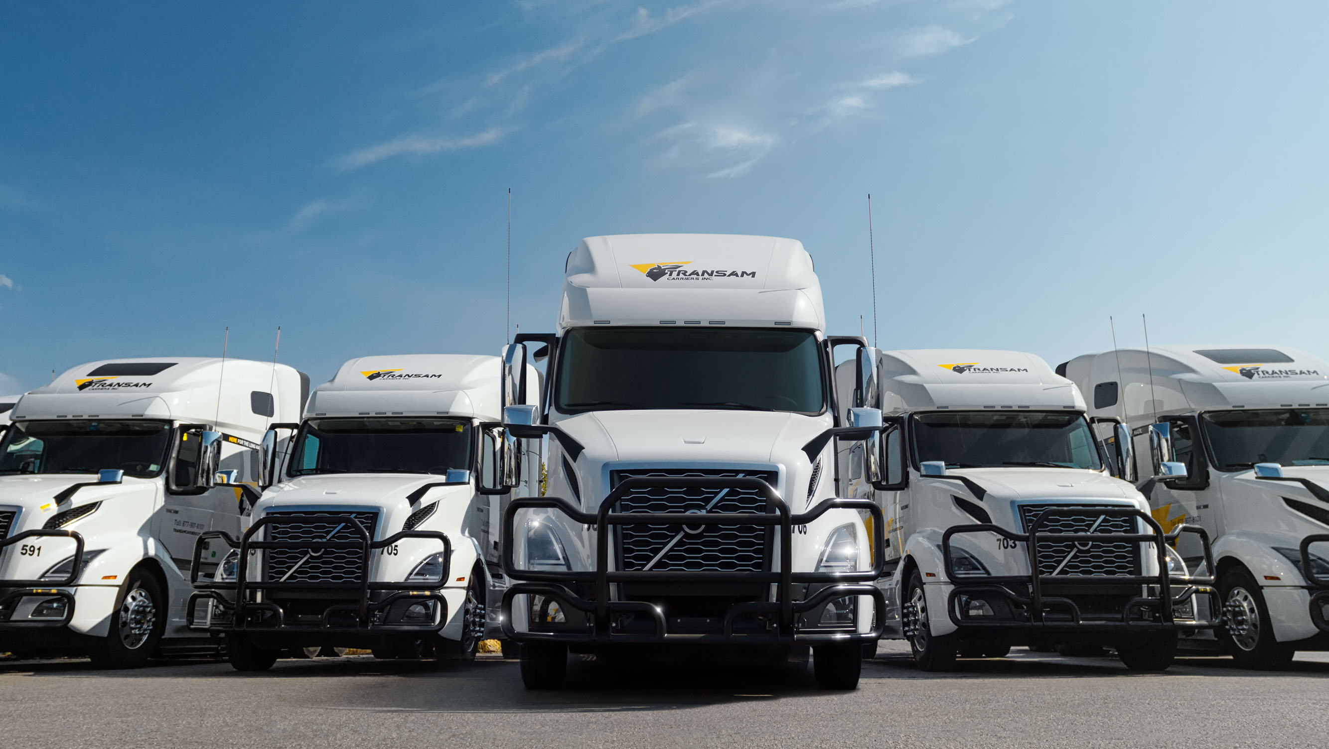

Mission Statement
To provide quality, cost effective and professional transportation services to our customers safely and reliably.

Slide 7
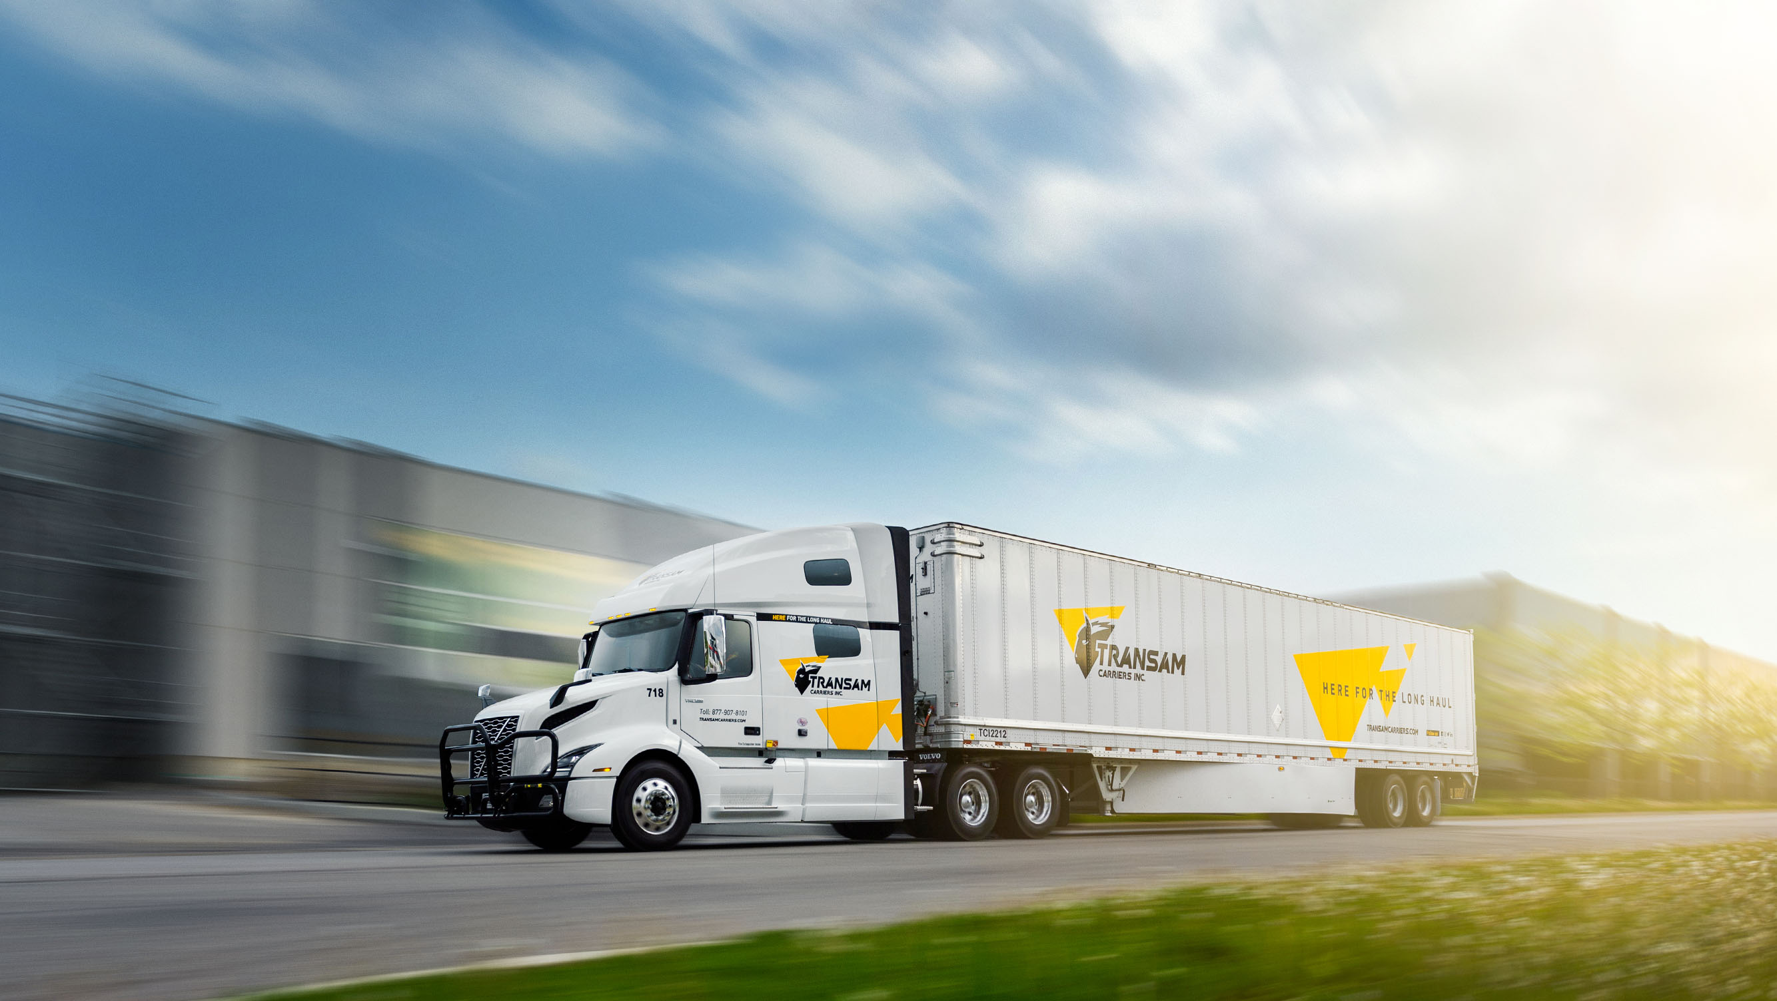
Vision Statement
Transam seeks to be the solution provider that builds and fosters long term relationships through our commitment to reliability, service, and expertise. Transam will supply custom tailored services to satisfy the unique needs of our clients.

Slide 8
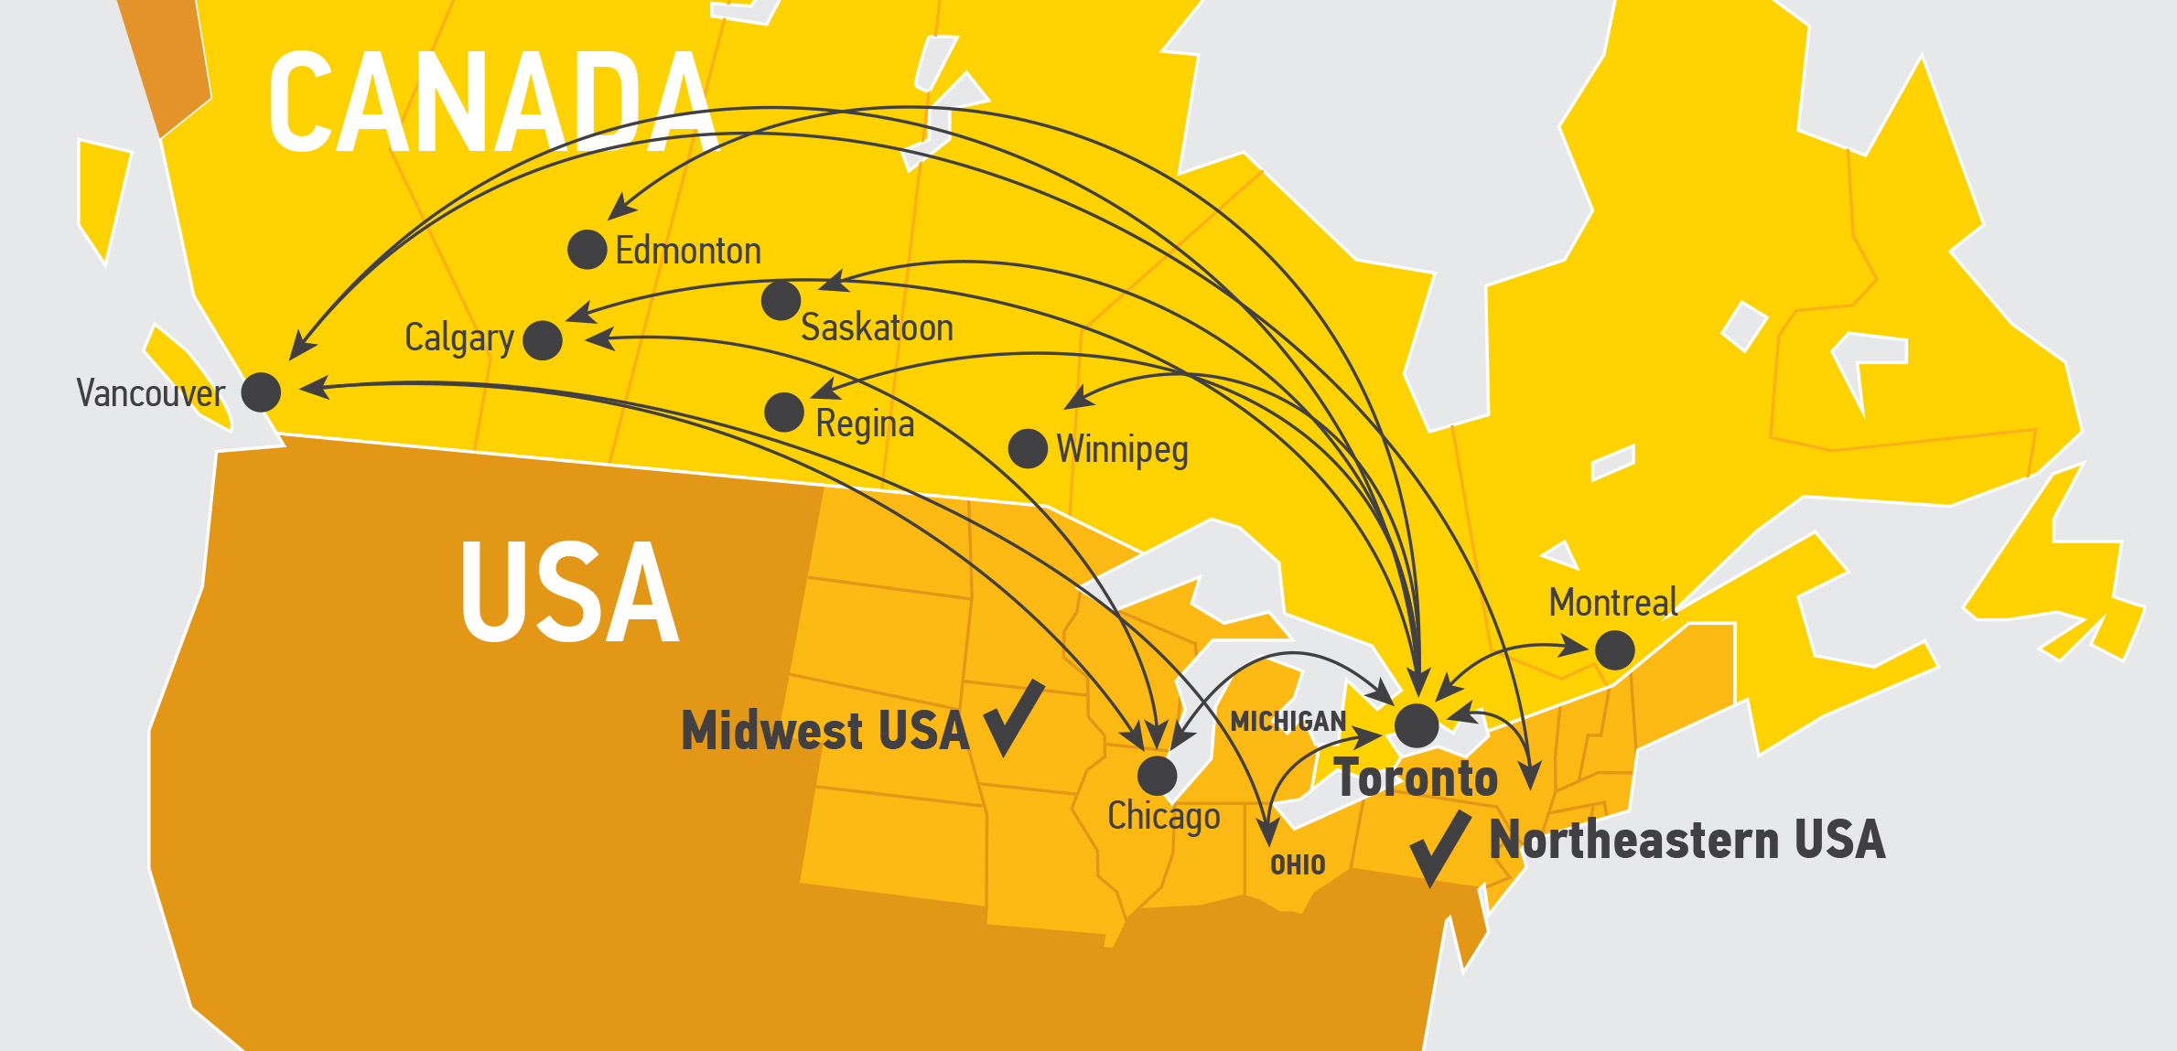
Coverage

Slide 9
Safety and Security
C-TPAT
FAST EXPRESS
E-Log equipped tractors
CSA
Pre and post trip inspections of all units
PIP
SAFETY
& SECURITY
24 hours surveillance of yard
SmartWay certified
Robust safety and security department
Drivers training & handling
of dangerous goods
Electronically controlled security gate
Satellite tracking of all units
Comprehensive Health and Safety Program

Slide 10
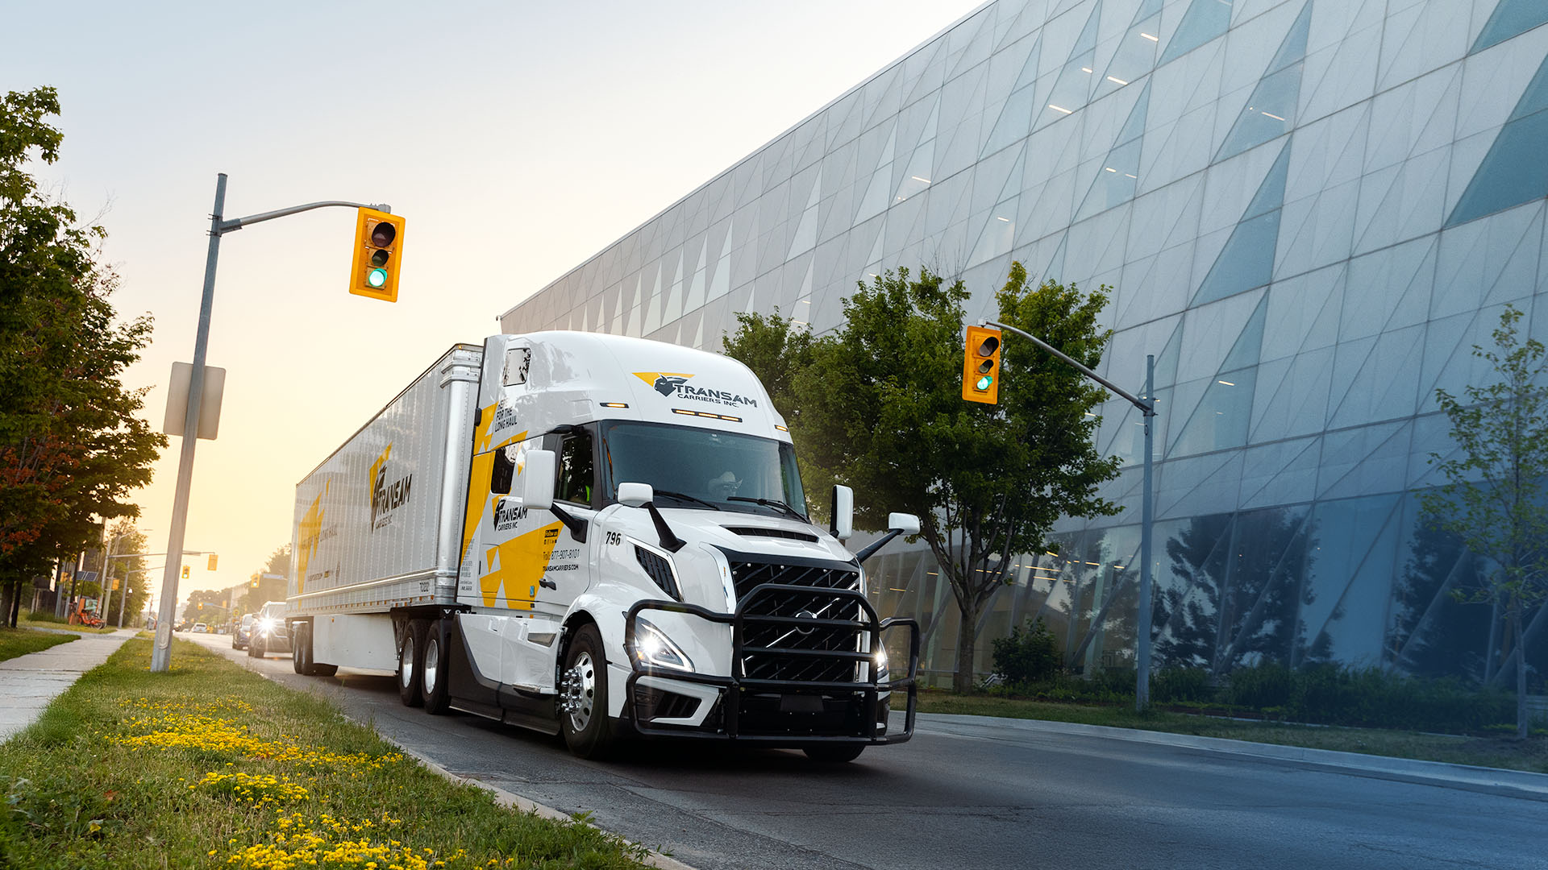
Equipment
At Transam Carriers, we believe reliable service starts with reliable equipment. That’s why we continuously invest in fleet upgrades – most recently with the addition of the new Volvo VNL 860 trucks.

Slide 11


Technology
Satellite tracking
Electronic dispatch
Trailer tracking devices
Telematic equipped vehicles
Electronic tracking
and tracing

Slide 12

Advantages
> 98.5% on time service
Low claim ratio
Skid rating
Predictable accurate invoicing
Expedited transit times
Dedicated dispatchers and customer service
Transborder experts
Solutions driven attitude
11

Slide 13
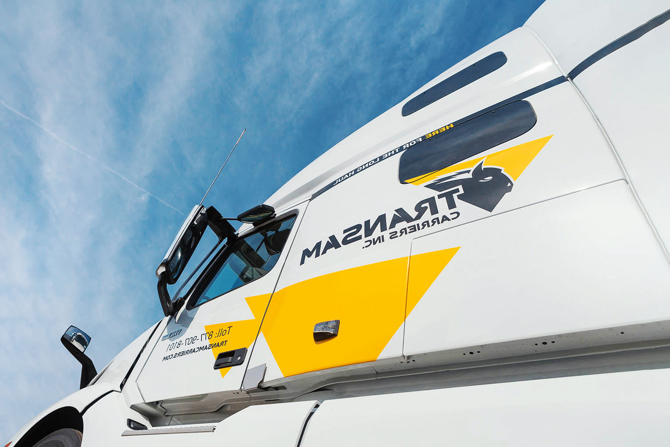





Contacts
Transam Carriers Inc.
Address: 205 Doney Crescent, Concord ON L4K 1P6
Tel.: 416-907-8101
Toll Free: 877-907-8101
Fax: 416-907-8102
Email: dispatch@transamcarriers.com
Website: www.transamcarriers.com
Follow us on social media:

Slide 14

THANK
YOU!

